Slide 1
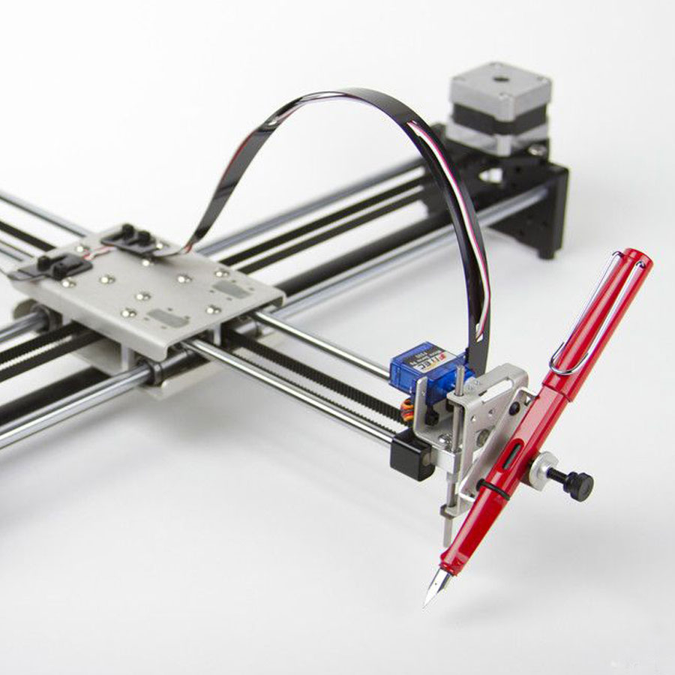
QWERTY Pen Personal Writing/Drawing Device
Praveen Gnanasekaran & Vijoy Sunil Kumar
Source: AxiDraw

Slide 2
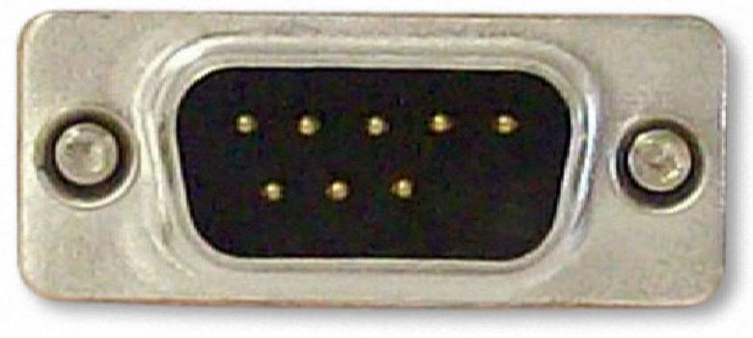
Hardware Implementation
STEPPER MOTORS 1 & 2
1
X
UART
PC
8051
STEPPER
MOTOR
DRIVER
SERVO MOTOR
2
abc
Python bitmap script
16x4
LCD
Y
LCD CONTROL BUTTON

Slide 3
Problems faced
Base and pen holder
Base not perfectly level (tried fixing with spirit levels)- resulting in the pen leaving impressions of different shades
Printing time made intentionally slower to get more uniform shades.
Bluetooth interface
Transmission through Bluetooth not fast and lead to loss of packets during two way transmissions- fixed by replacing Bluetooth with wired UART
Initial mechanical problems

